Slide 1
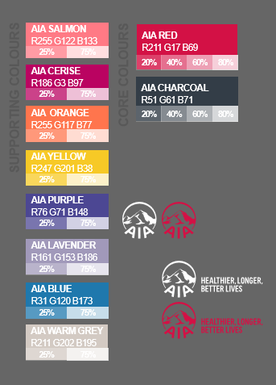
“
Building a business is not easy. I tried to start a business a lot of times before and somehow failed caused by a series of unfortunate events. But when I joined AIA Philippines, everything seems so simple. AIA Philippines’ solid support system which includes innovative digital tools, world-class training and performance-based compensation empowered me to succeed as an AIA Life Planner.
<NAME>
AIA LIFE PLANNER
<AGENCY>
[Your
Agency Logo]

