Slide 1
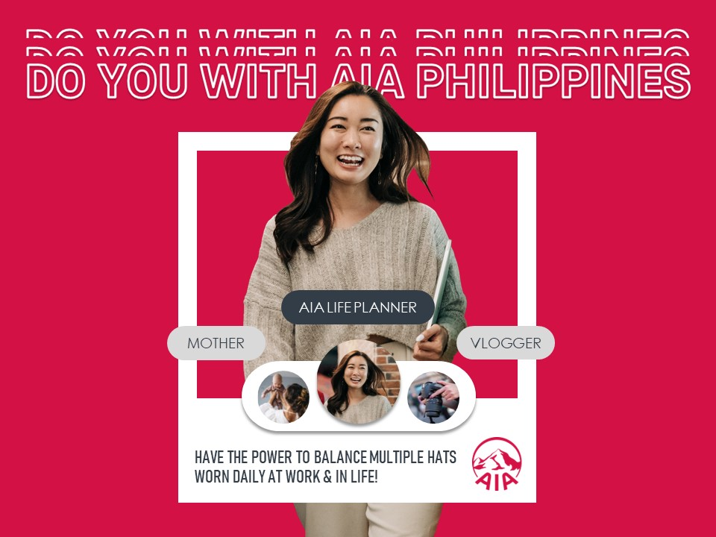
THIS SLIDE WILL SERVE AS YOUR GUIDE

Slide 2
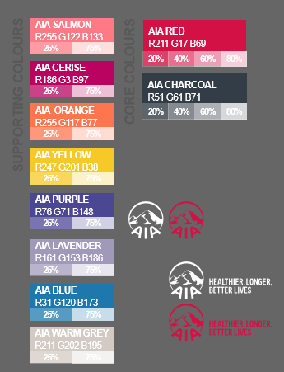
CUSTOMIZE HERE
AIA LIFE PLANNER
MOTHER
VLOGGER
HAVE THE POWER TO BALANCE MULTIPLE HATS
WORN DAILY AT WORK & IN LIFE!

