Slide 1
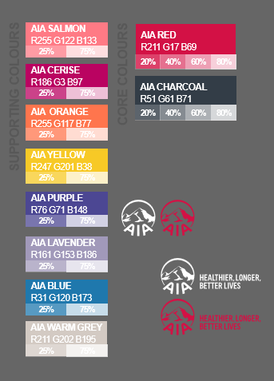
“
Being an AIA Life Planner opened my eyes to a lot of opportunities. When I was younger, I wanted to build my own business and help other people through it. Fortunately, I found AIA Philippines and partnering with them made my dream come true by Helping People Live Healthier, Longer, and Better Lives.
<NAME>
AIA Life Planner
<AGENCY>
[Your
Agency Logo]

